Slide 1


Slide 2
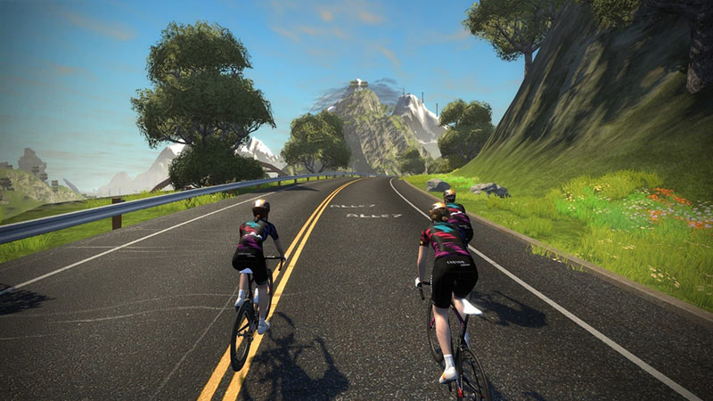
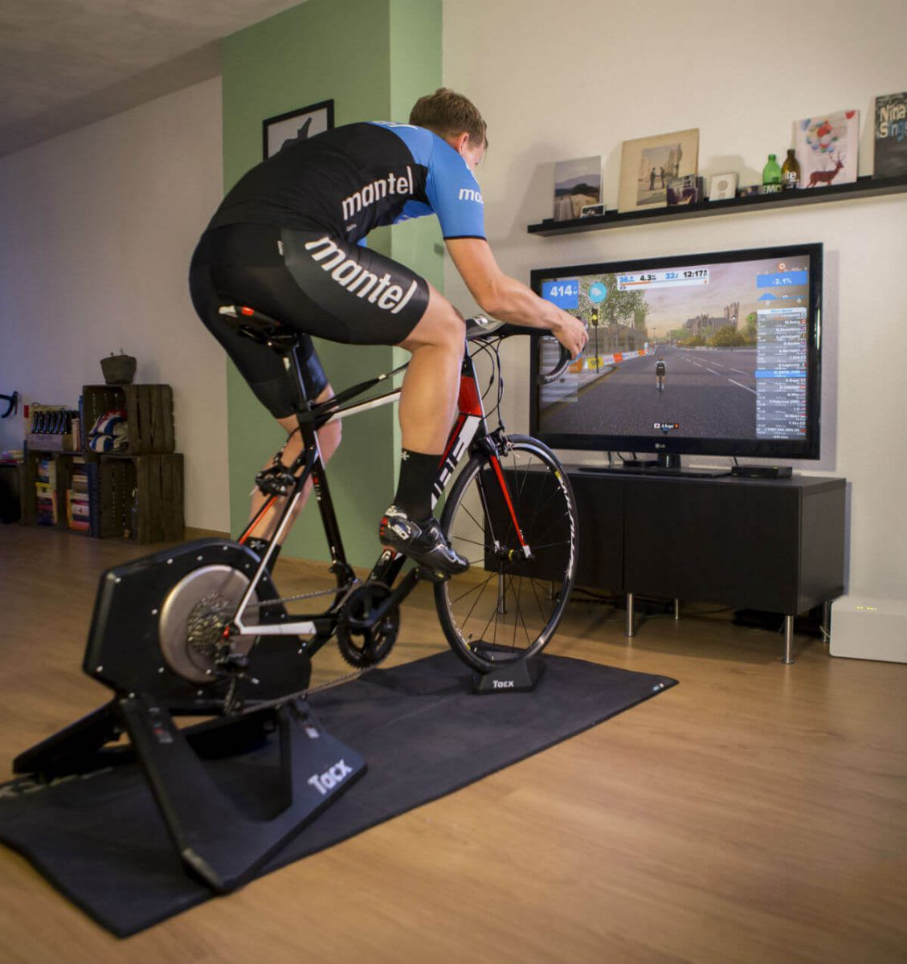
Objective
Zwift : Graphic Card needed.
GTX 1050 (160euros) : 3x Faster than CPU

Slide 3
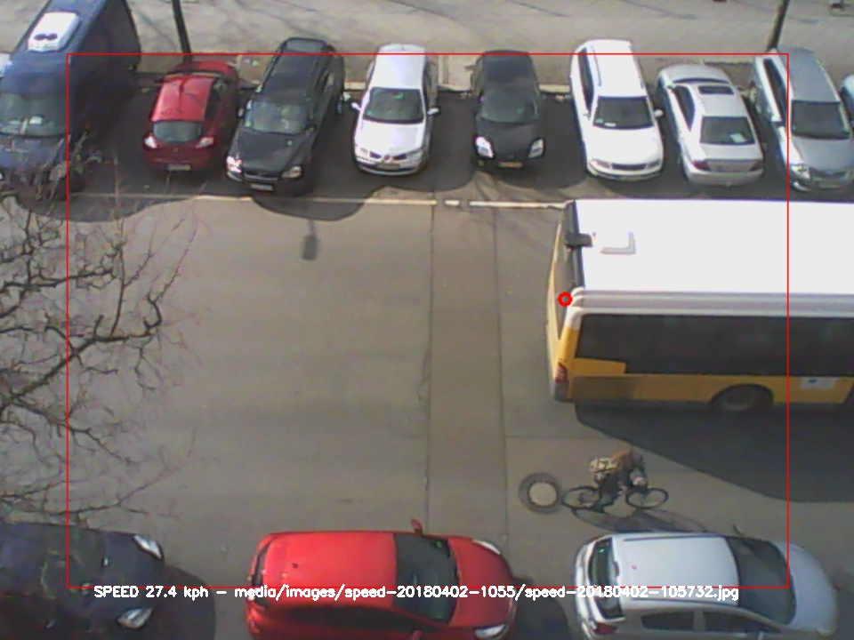
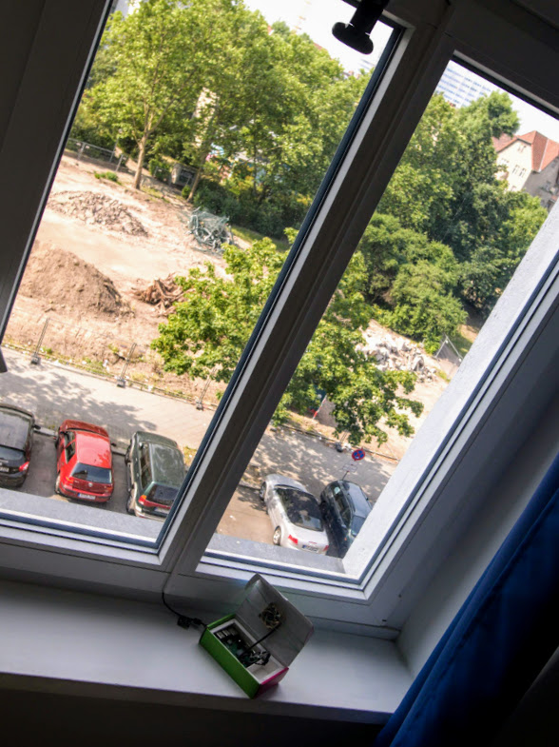
Reality
SpeedCam : OpenCV based speed calculation. Runs on Rasperry Pi.

Slide 4
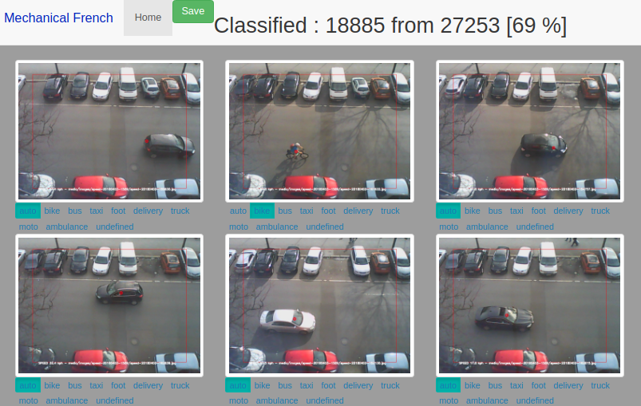
The mechanical french

Slide 5
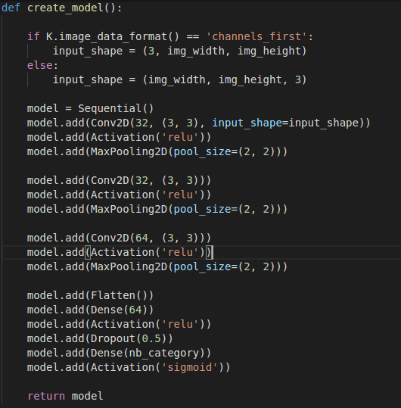

Deep Learning

Slide 6
Binary Classification
Bike or Car ?
Training on 20000 pictures : 97% accuracy.
Prediction on 230000 Pictures : 2 hours.

Slide 7
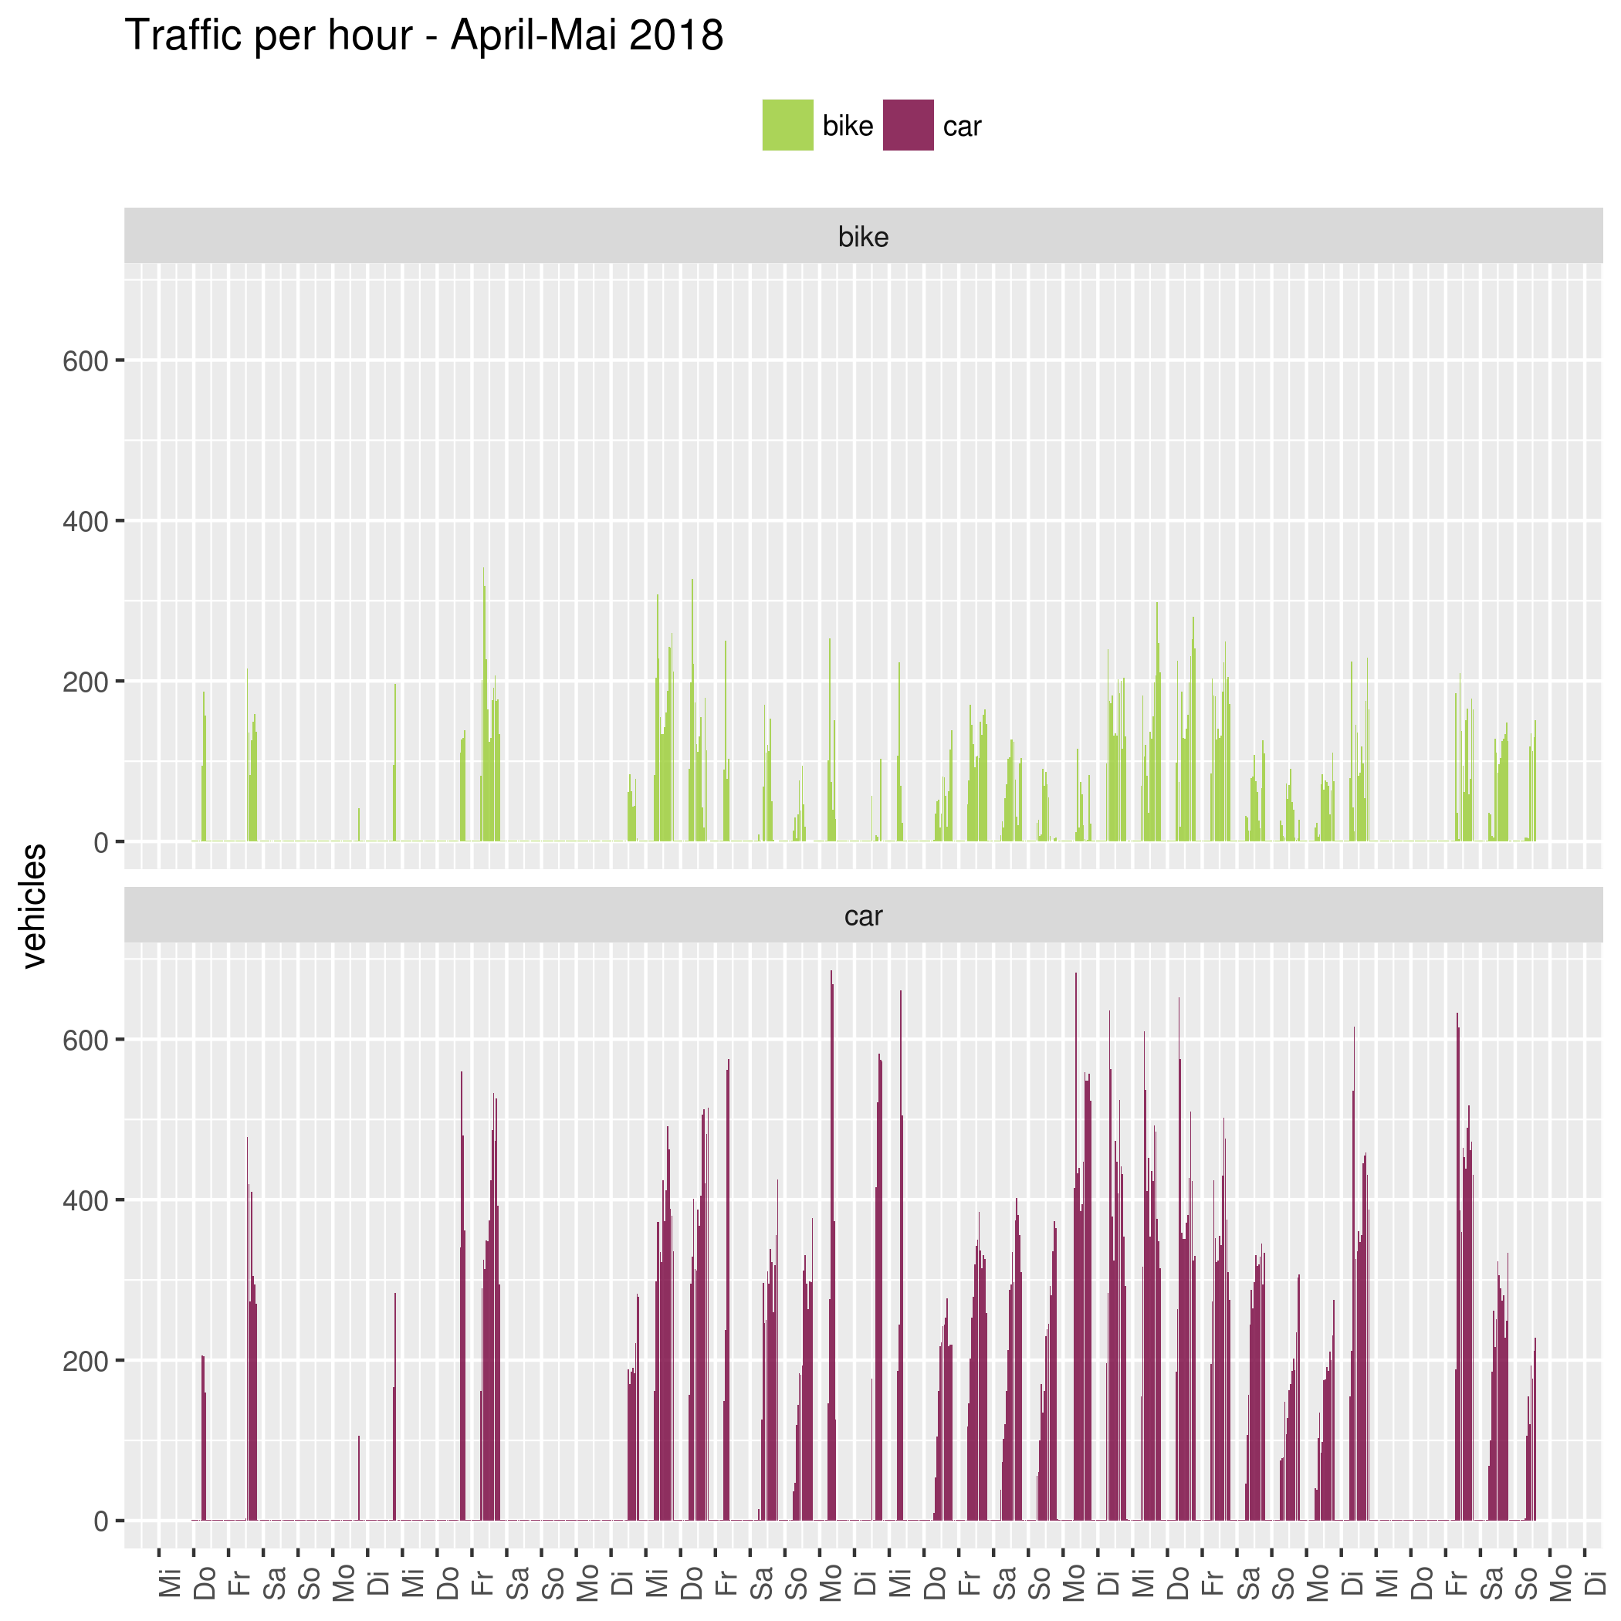

Slide 8
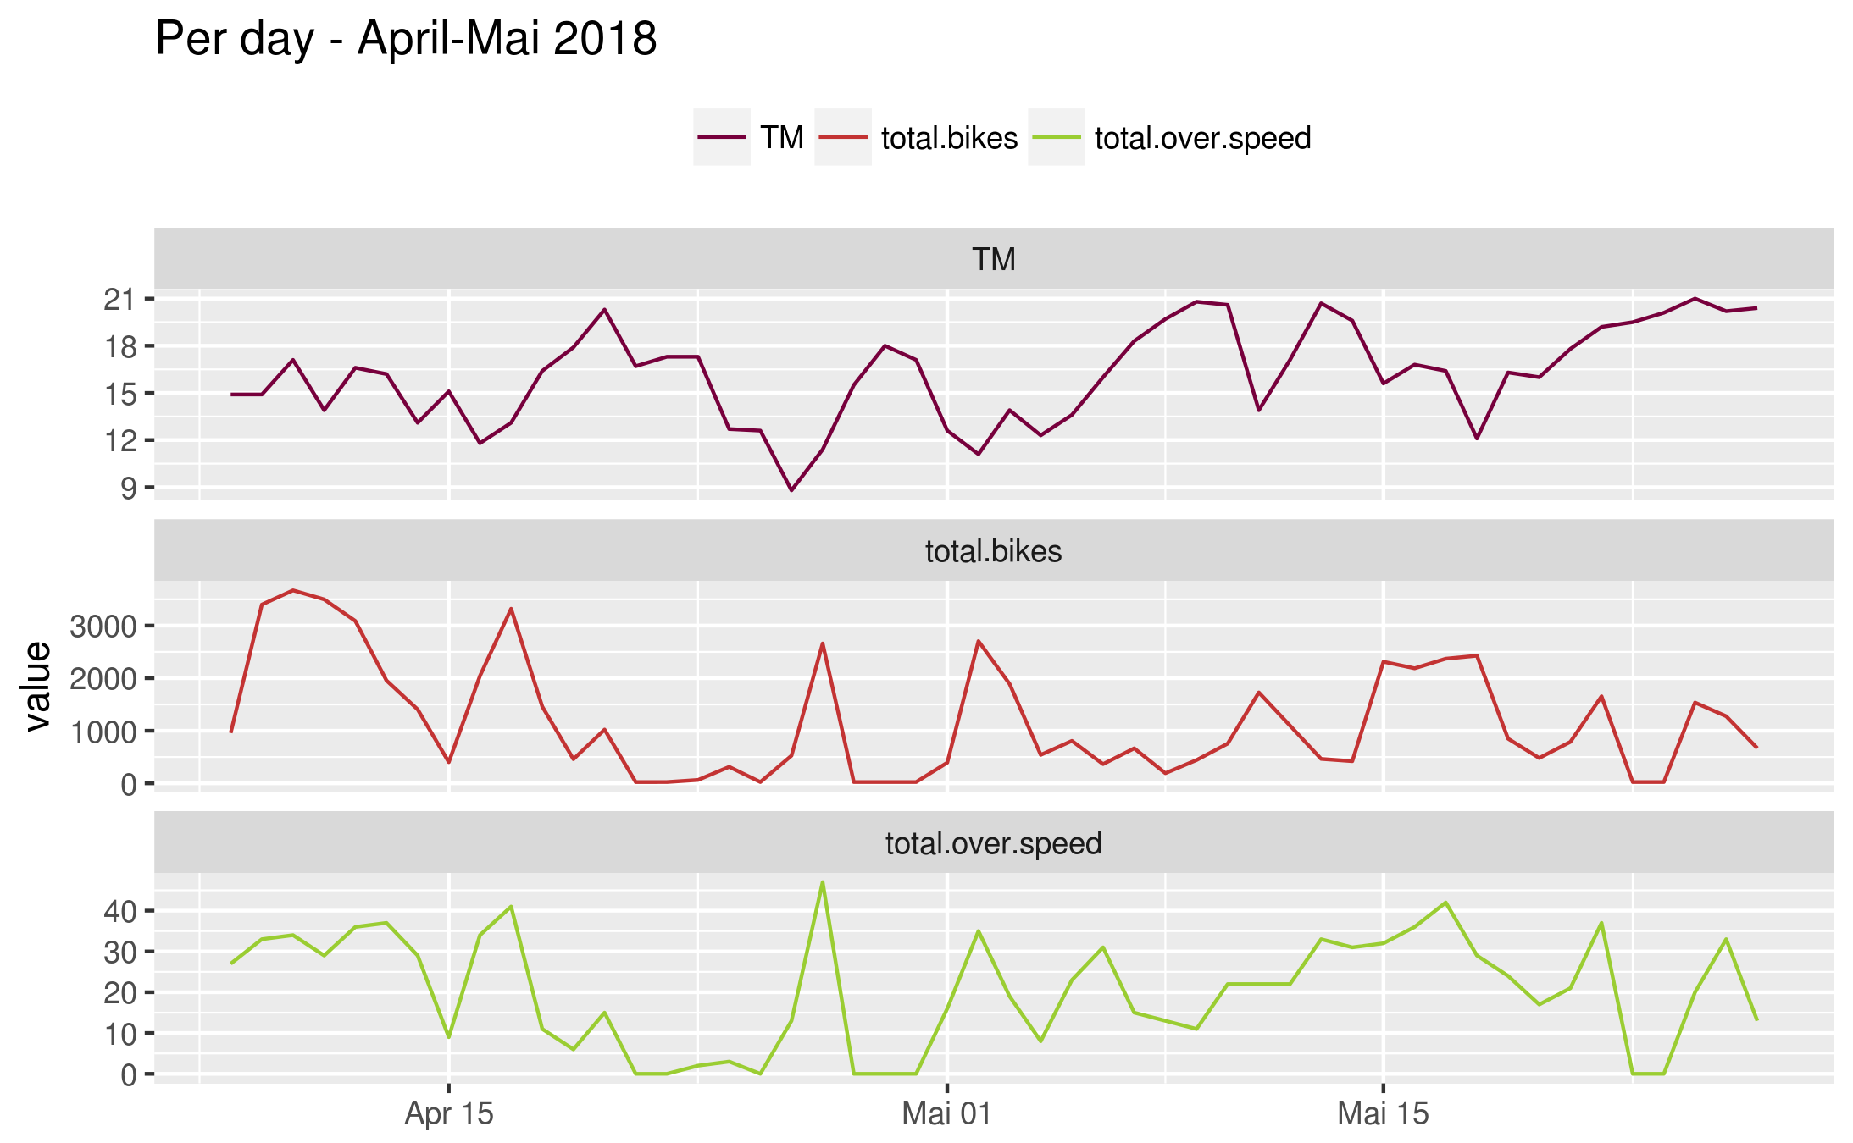
Fahrrad ist schuld.
Call:
lm(formula = total.over.speed ~ TM + total.bikes, data = groupy.per.date)
Residuals:
Min 1Q Median 3Q Max
-14.009 -7.292 -1.516 6.292 19.274
Coefficients:
Estimate Std. Error t value Pr(>|t|)
(Intercept) 2.374369 7.628047 0.311 0.757
TM 0.351326 0.429497 0.818 0.417
total.bikes 0.010221 0.001207 8.471 5.1e-11 ***
---
Residual standard error: 8.691 on 47 degrees of freedom
Multiple R-squared: 0.6158, Adjusted R-squared: 0.5995
F-statistic: 37.67 on 2 and 47 DF, p-value: 1.726e-10

Slide 9
REX
Check sensor integrity
Use picture labelling framework (Hella ANNOSTATION LABELING SYSTEM)
Deep Learning better on cloud

